Slide 1
3
Introduction to Classes and Objects

Slide 2
OBJECTIVES
In this chapter you will learn:
What classes, objects, member functions and data members are.
How to define a class and use it to create an object.
How to define member functions in a class to implement the class's behaviors.
How to declare data members in a class to implement the class's attributes.
How to call a member function of an object to make that member function perform its task.
The differences between data members of a class and local variables of a function.
How to use a constructor to ensure that an object's data is initialized when the object is created.
How to engineer a class to separate its interface from its implementation and encourage reuse.

Slide 3
3.1 Introduction
3.2 Classes, Objects, Member Functions and Data Members
3.3 Overview of the Chapter Examples
3.4 Defining a Class with a Member Function
3.5 Defining a Member Function with a Parameter
3.6 Data Members, set Functions and get Functions
3.7 Initializing Objects with Constructors
3.8 Placing a Class in a Separate File for Reusability
3.9 Separating Interface from Implementation
3.10 Validating Data with set Functions

Slide 4
3.1 Introduction
Programs from Chapter 2
  All statements were located in function main
Typically
  Programs will consist of
    Function main and
    One or more classes
      Each containing data members and member functions

Slide 5
3.3 Overview of the Chapter Examples
Seven simple examples
  Examples used to build a GradeBook class
Topics covered:
  Member functions
  Data members
  Clients of a class
    Other classes or functions that call the member functions of this class’s objects
  Separating interface from implementation
  Data validation
    Ensures that data in an object is in a particular format or range

Slide 6
3.4 Defining a Class With a Member Function
Class definition
  Tells compiler what member functions and data members belong to the class
  Keyword class followed by the class’s name
  Class body is enclosed in braces ({})
    Specifies data members and member functions
    Access-specifier public:
      Indicates that a member function or data member is accessible to other functions and member functions of other classes

Slide 7
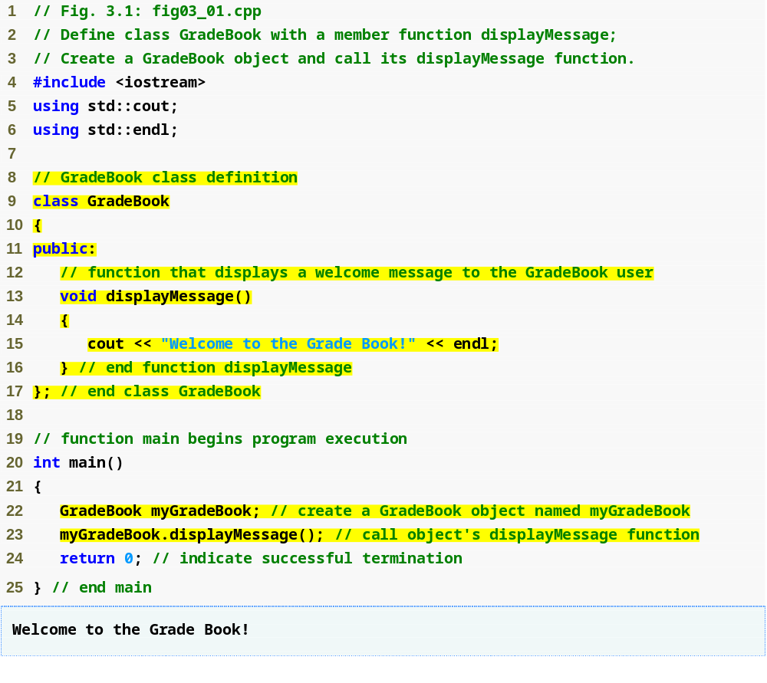
Outline
fig03_01.cpp
(1 of 1)
Beginning of class definition for class GradeBook
Beginning of class body
Access specifier public; makes members available to the public
Member function displayMessge returns nothing
End of class body
Use dot operator to call GradeBook’s member function

Slide 8
3.4 Defining a Class With a Member Function (Cont.)
Member function definition
  Return type of a function
    Indicates the type of value returned by the function when it completes its task
    void indicates that the function does not return any value
  Function names must be a valid identifier
  Parentheses after function name indicate that it is a function
  Function body contains statements that perform the function’s task
    Delimited by braces ({})

Slide 9
3.4 Defining a Class With a Member Function (Cont.)
Using a class
  A class is a user-defined type (or programmer-defined type)
    Can be used to create objects
      Variables of the class type
    C++ is an extensible language
  Dot operator (.)
    Used to access an object’s data members and member functions
    Example
      myGradeBook.displayMessage()
        Call member function displayMessage of GradeBook with object myGradeBook

Slide 10
3.5 Defining a Member Function with a Parameter (Cont.)
A string
  Represents a string of characters
  An object of C++ Standard Library class std::string
    Defined in header file <string>
Library function getline
  Used to retrieve input until newline is encountered
  Example
    getline( cin, nameOfCourse );
      Inputs a line from standard input into string object nameOfCourse

Slide 11
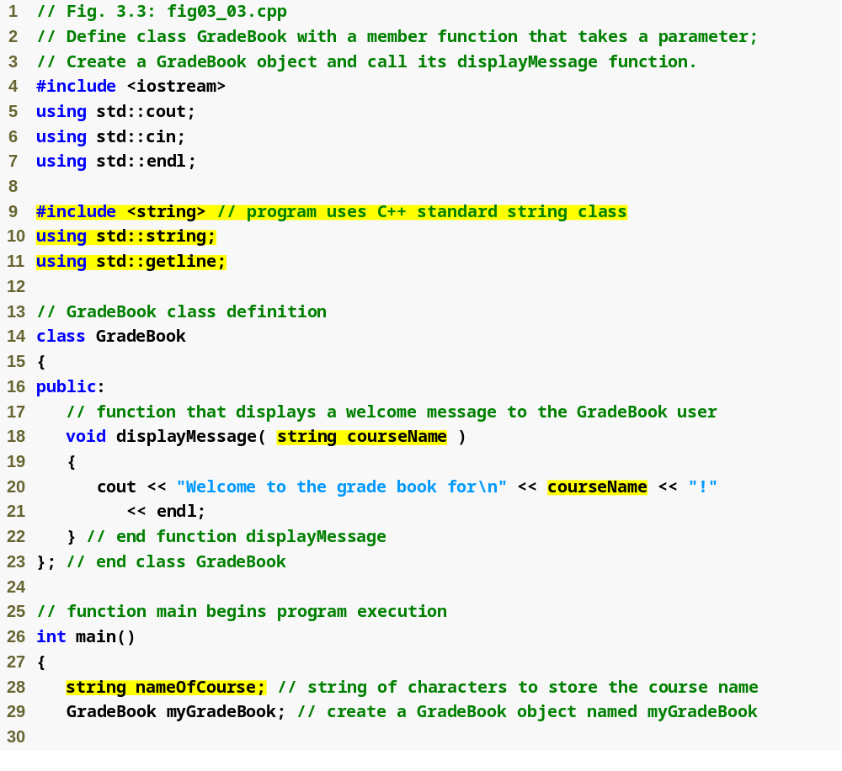
Outline
Include string class definition
fig03_03.cpp
(1 of 2)
Member function parameter
Use the function parameter as a variable

Slide 12
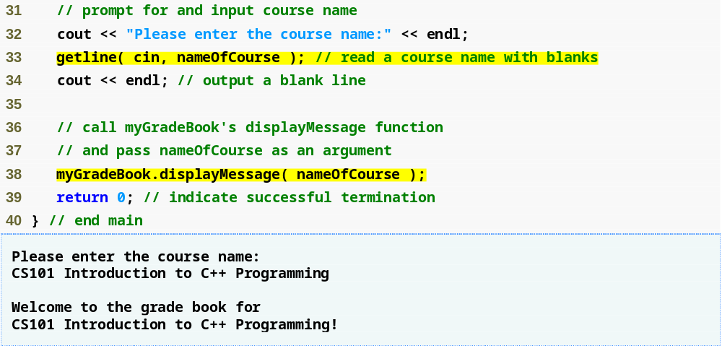
Outline
fig03_03.cpp
(2 of 2)
Passing an argument to the member function

Slide 13
3.6 Data Members, set Functions and get Functions
Local variables
  Variables declared in a function definition’s body
    Cannot be used outside of that function body
  When a function terminates
    The values of its local variables are lost
Attributes
  Exist throughout the life of the object
  Represented as data members
    Variables in a class definition
  Each object of class maintains its own copy of attributes

Slide 14
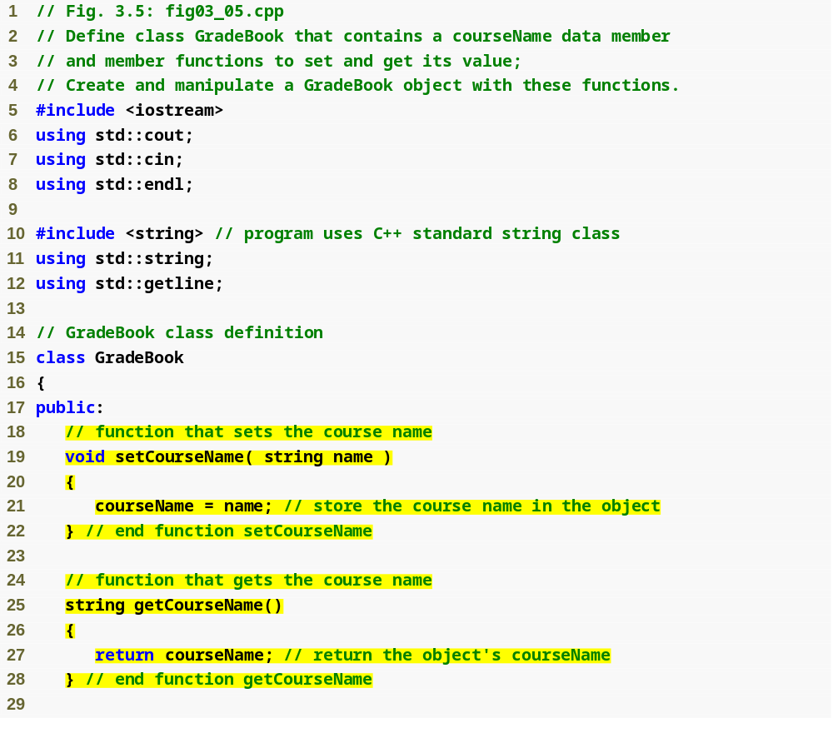
Outline
fig03_05.cpp
(1 of 3)
set function modifies private data
get function accesses private data

Slide 15
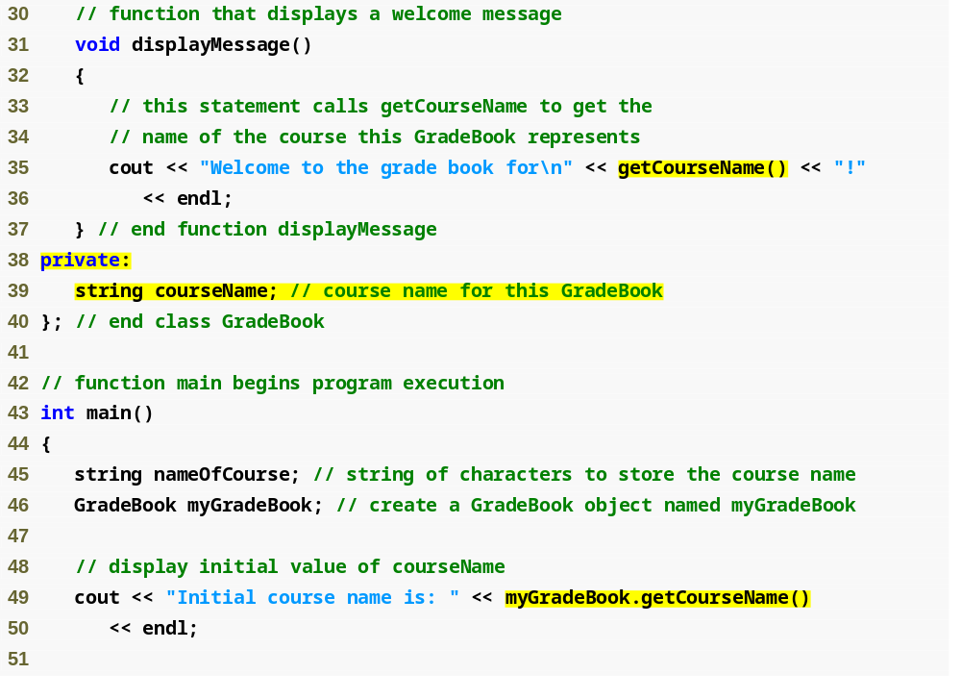
Outline
fig03_05.cpp
(2 of 3)
Use set and get functions, even within the class
private members accessible only to member functions of the class
Accessing private data outside class definition

Slide 16
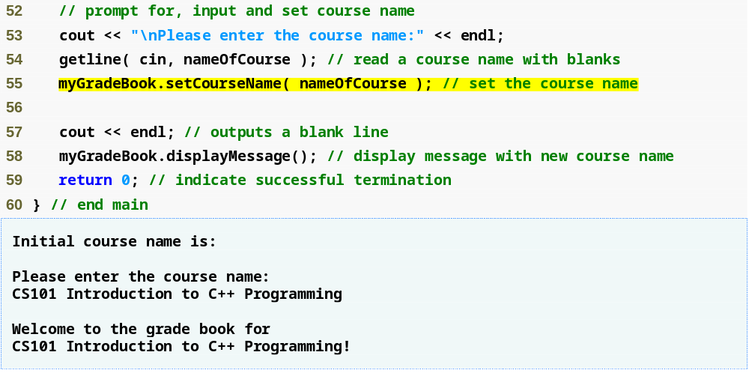
Outline
fig03_05.cpp
(3 of 3)
Modifying private data outside class definition

Slide 17
3.6 Data Members, set Functions and get Functions (Cont.)
Access-specifier private
  Makes a data member or member function accessible only to member functions of the class
  private is the default access for class members
  Data hiding
Returning a value from a function
  A function that specifies a return type other than void
    Returns a value to its calling function

Slide 18
3.6 Data Members, set Functions and get Functions (Cont.)
Software engineering with set and get functions
  public member functions that allow clients of a class to set or get the values of private data members
  set functions sometimes called mutators and get functions sometimes called accessors
  Allows the creator of the class to control how clients access private data
  Should also be used by other member functions of the same class

Slide 19
3.7 Initializing Objects with Constructors
Constructors
  Functions used to initialize an object’s data when it is created
    Call made implicitly when object is created
    Must be defined with the same name as the class
    Cannot return values
      Not even void
  Default constructor has no parameters
    The compiler will provide one when a class does not explicitly include a constructor
      Compiler’s default constructor only calls constructors of data members that are objects of classes

Slide 20
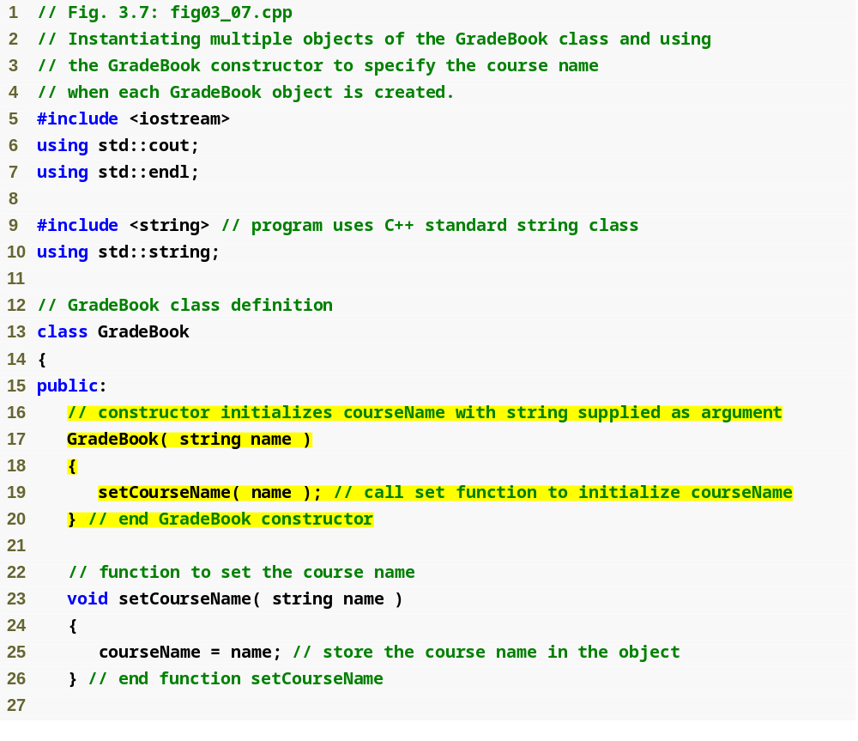
Outline
fig03_07.cpp
(1 of 3)
Constructor has same name as class and no return type
Initialize data member

Slide 21
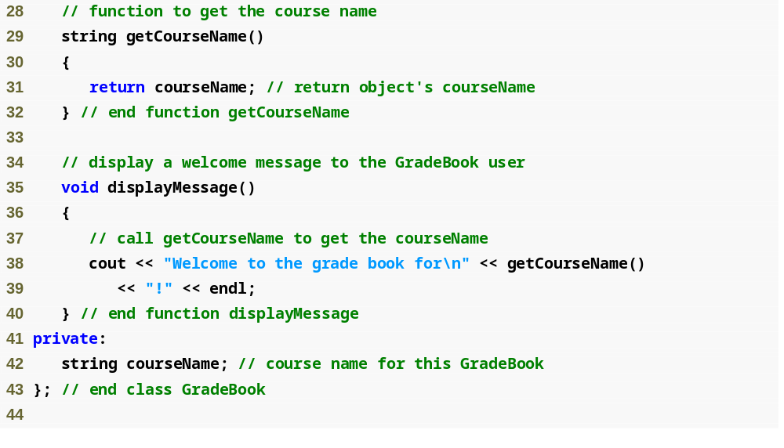
Outline
fig03_07.cpp
(2 of 3)

Slide 22
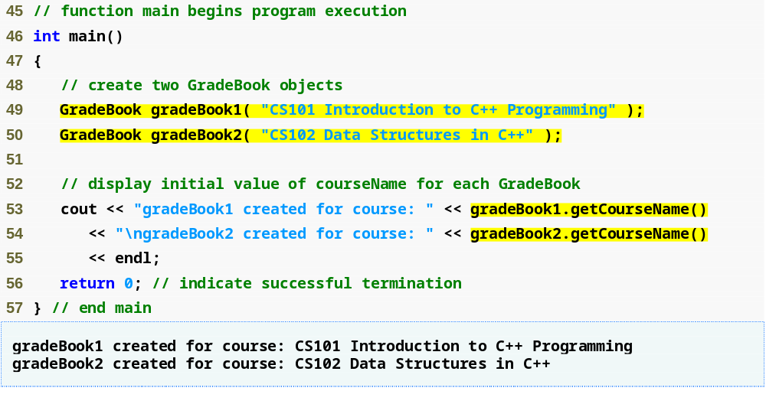
Outline
fig03_07.cpp
(3 of 3)
Creating objects implicitly calls the constructor

Slide 23
3.8 Placing a Class in a Separate File for Reusability
.cpp file is known as a source-code file
Header files
  Separate files in which class definitions are placed
    Allow compiler to recognize the classes when used elsewhere
  Generally have .h filename extensions
Driver files
  Program used to test software (such as classes)
  Contains a main function so it can be executed

Slide 24
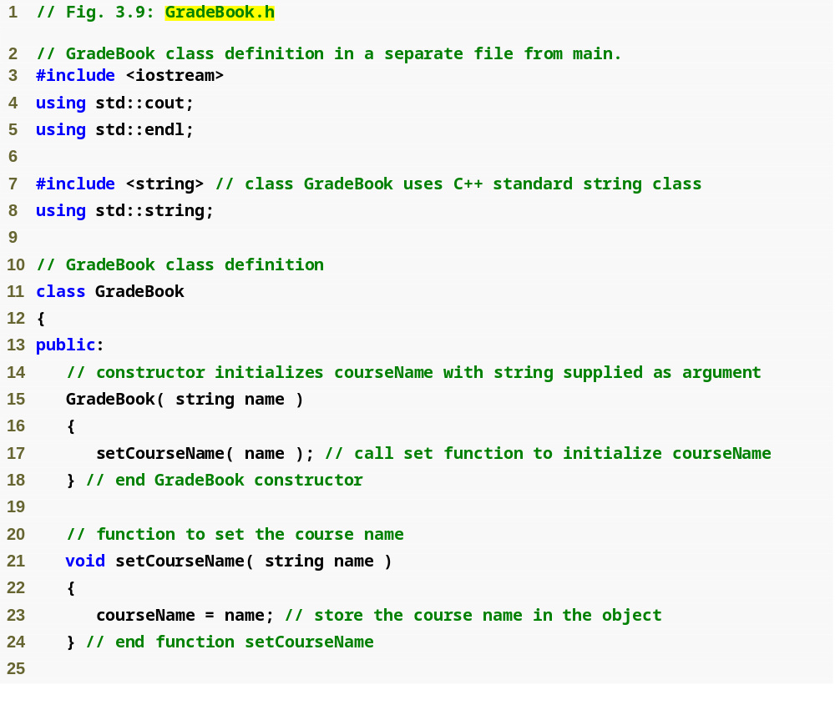
Outline
Class definition is in a header file
fig03_09.cpp
(1 of 2)

Slide 25
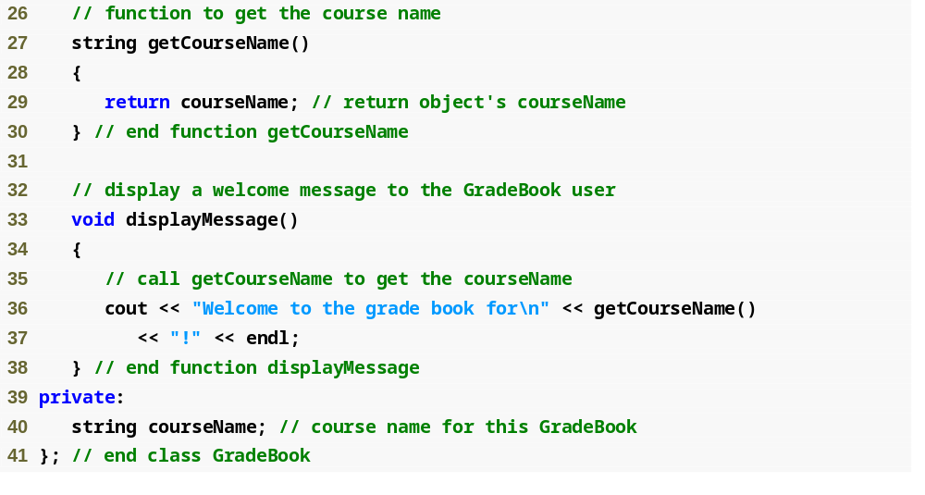
Outline
fig03_09.cpp
(2 of 2)

Slide 26
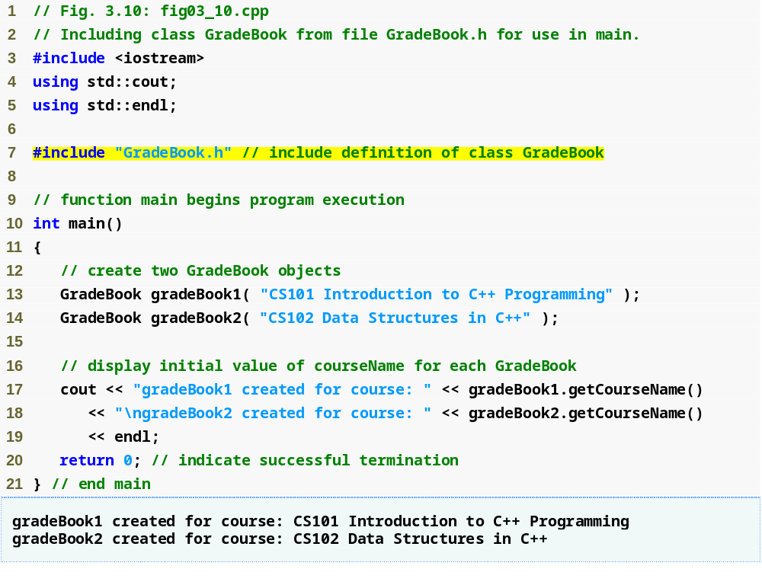
Outline
fig03_10.cpp
(1 of 1)
Including the header file causes the class definition to be copied into the file

Slide 27
3.8 Placing a Class in a Separate File for Reusability (Cont.)
#include preprocessor directive
  Used to include header files
    Instructs C++ preprocessor to replace directive with a copy of the contents of the specified file
  Quotes indicate user-defined header files
    Preprocessor first looks in current directory
      If the file is not found, looks in C++ Standard Library directory
  Angle brackets indicate C++ Standard Library
    Preprocessor looks only in C++ Standard Library directory

Slide 28
3.8 Placing a Class in a Separate File for Reusability (Cont.)
Creating objects
  Compiler must know size of object
    C++ objects typically contain only data members
    Compiler creates one copy of class’s member functions
      This copy is shared among all the class’s objects

Slide 29
3.9 Separating Interface from Implementation
Interface
  Describes what services a class’s clients can use and how to request those services
    But does not reveal how the class carries out the services
    A class definition that lists only member function names, return types and parameter types
      Function prototypes
  A class’s interface consists of the class’s public member functions (services)
Separating interface from implementation
  Client code should not break if implementation changes, as long as interface stays the same

Slide 30
3.9 Separating Interface from Implementation (Cont.)
Separating interface from implementation (Cont.)
  Define member functions outside the class definition, in a separate source-code file
    In source-code file for a class
      Use binary scope resolution operator (::) to tie each member function to the class definition
    Implementation details are hidden
      Client code does not need to know the implementation
  In header file for a class
    Function prototypes describe the class’s public interface

Slide 31
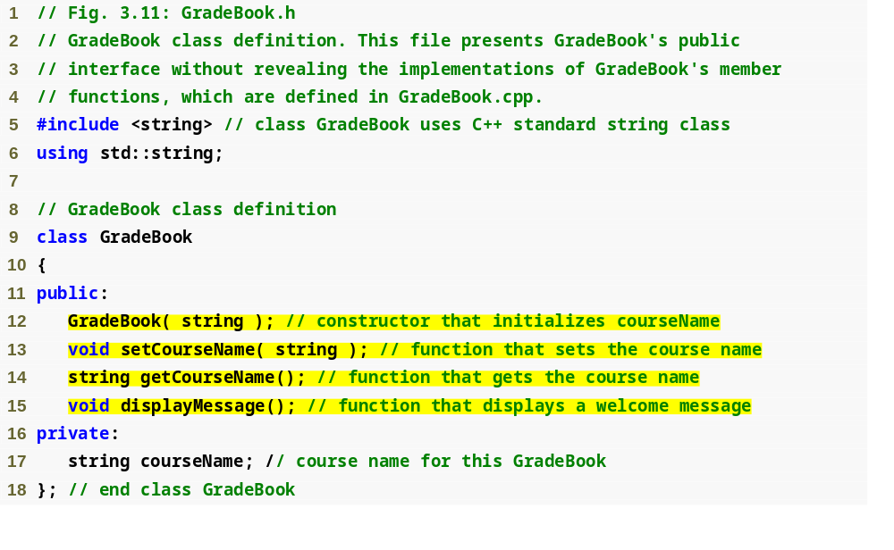
Outline
fig03_11.cpp
(1 of 1)
Interface contains data members and member function prototypes

Slide 32
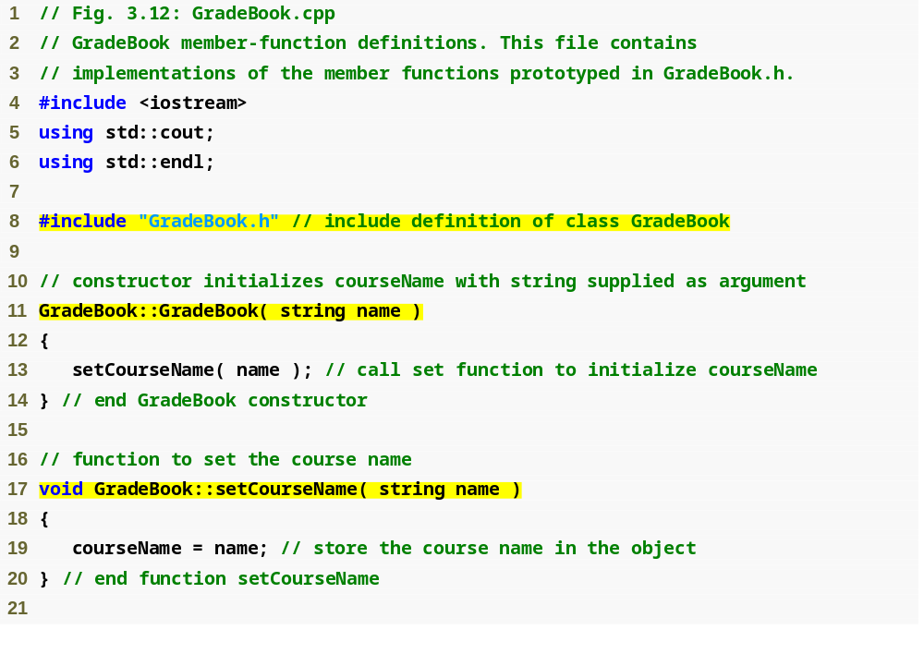
Outline
GradeBook implementation is placed in a separate source-code file
fig03_12.cpp
(1 of 2)
Include the header file to access the class name GradeBook
Binary scope resolution operator ties a function to its class

Slide 33
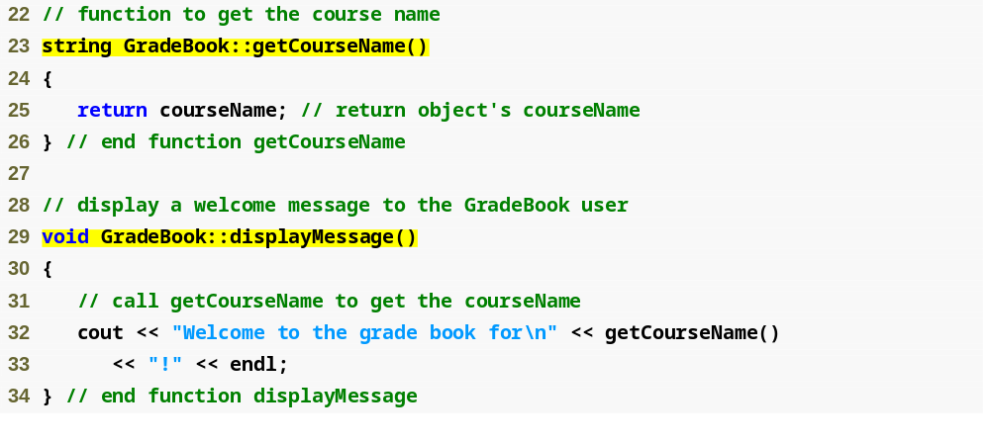
Outline
fig03_12.cpp
(2 of 2)

Slide 34
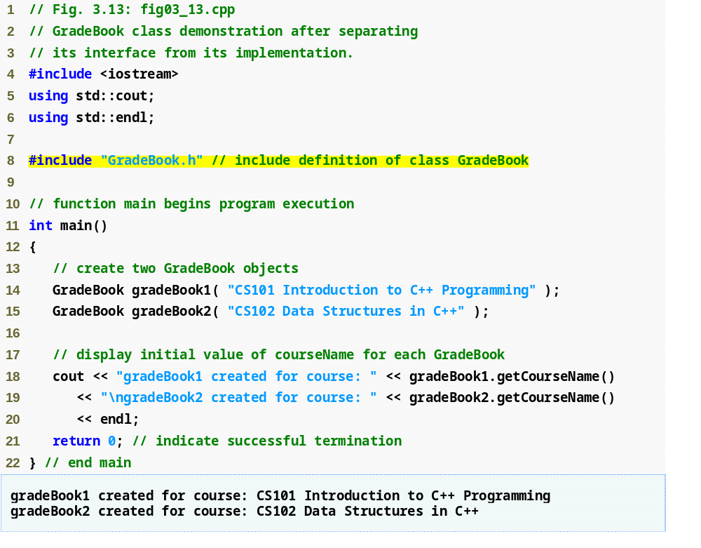
Outline
fig03_13.cpp
(1 of 1)

Slide 35
3.9 Separating Interface from Implementation (Cont.)
The Compilation and Linking Process
  Source-code file is compiled to create the class’s object code (source-code file must #include header file)
    Class implementation programmer only needs to provide header file and object code to client
  Client must #include header file in their own code
    So compiler can ensure that the main function creates and manipulates objects of the class correctly
  To create executable application
    Object code for client code must be linked with the object code for the class and the object code for any C++ Standard Library object code used in the application

Slide 36
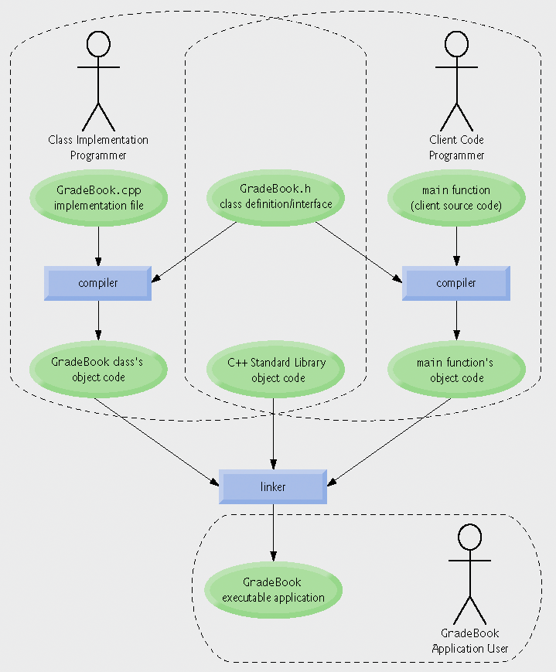
Fig.3.14 | Compilation and linking process that produces an executable application.

Slide 37
3.10 Validating Data with set Functions
set functions can validate data
  Known as validity checking
  Keeps object in a consistent state
    The data member contains a valid value
  Can return values indicating that attempts were made to assign invalid data
string member functions
  length returns the number of characters in the string
  Substr returns specified substring within the string

Slide 38
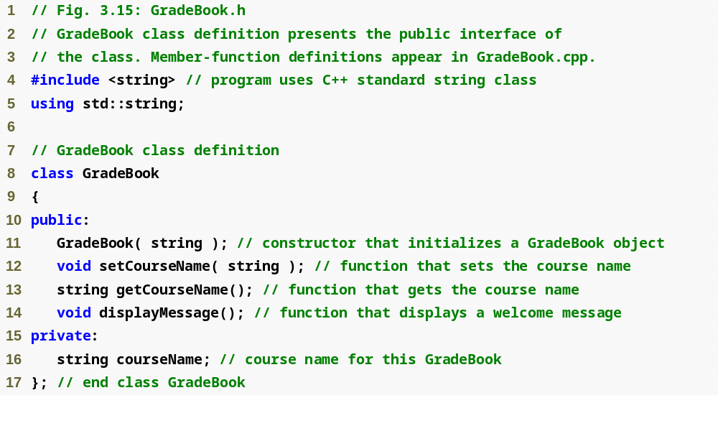
Outline
fig03_15.cpp
(1 of 1)

Slide 39
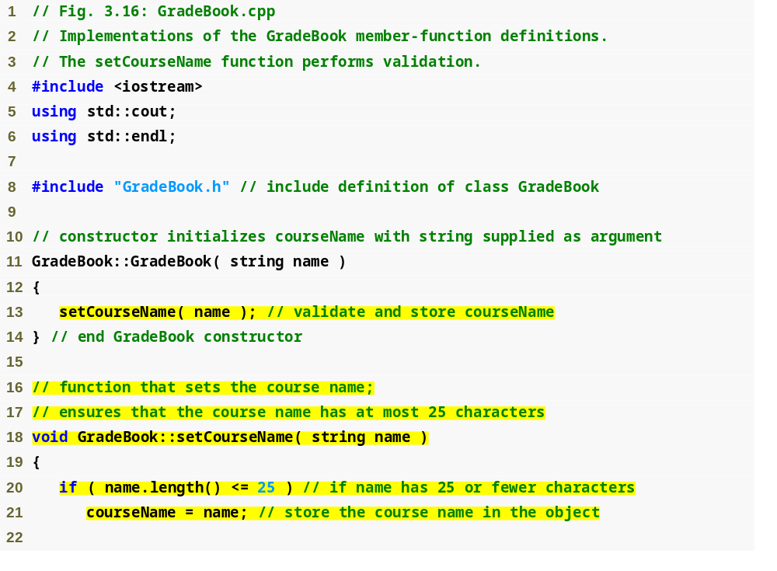
Outline
fig03_16.cpp
(1 of 2)
Constructor calls set function to perform validity checking
set functions perform validity checking to keep courseName in a consistent state

Slide 40
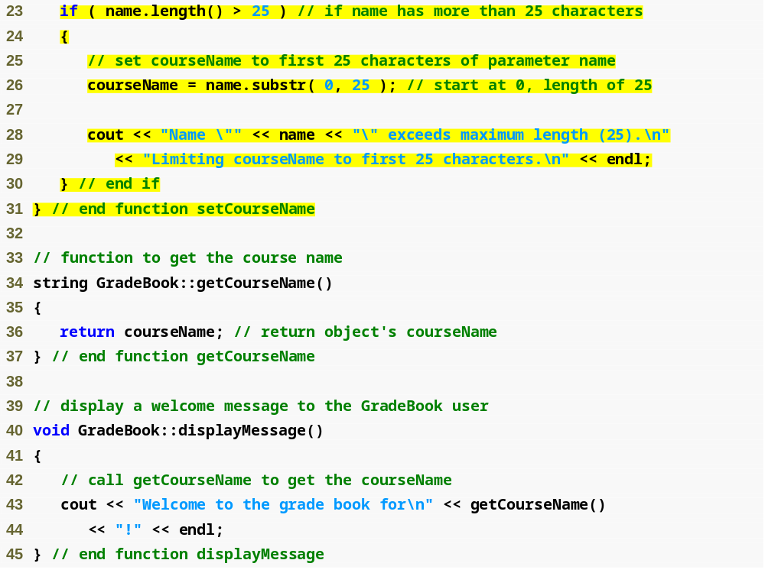
Outline
fig03_16.cpp
(2 of 2)

Slide 41
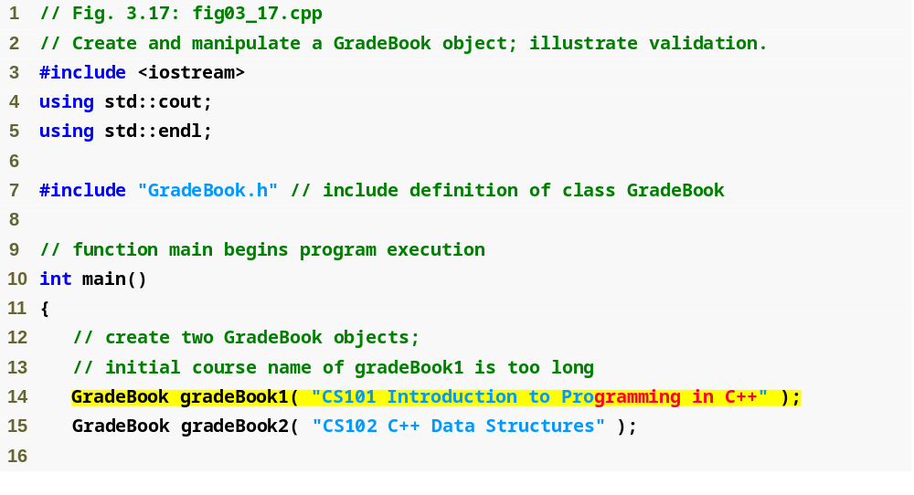
Outline
fig03_17.cpp
(1 of 2)
Constructor will call set function to perform validity checking

Slide 42
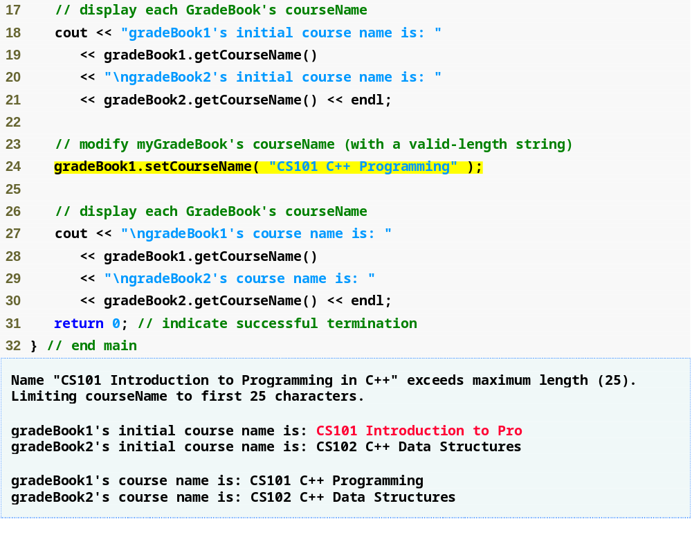
Outline
fig03_17.cpp
(2 of 2)
Call set function to perform validity checking

